Slide 1
The Walking Habits of Indian Trail
546
Survey responses
How long have you LIVED in Indian Trail?
WHY do you choose to walk?
How OFTEN do you walk within or around Indian Trail?
<1 year
73% walk for exercise
32%
Daily
1-5 years
30%
Weekly
10+ years
64% walk to enjoy nature/weather
10%
Monthly
5%
Yearly
6-10 years
40% walk for social time
23%
Never
Most survey respondents have lived in Indian Trail for over 6 years.
Survey respondents mostly walk for recreational purposes.
Most people walk frequently or not at all—there is not much in-between.

Slide 2
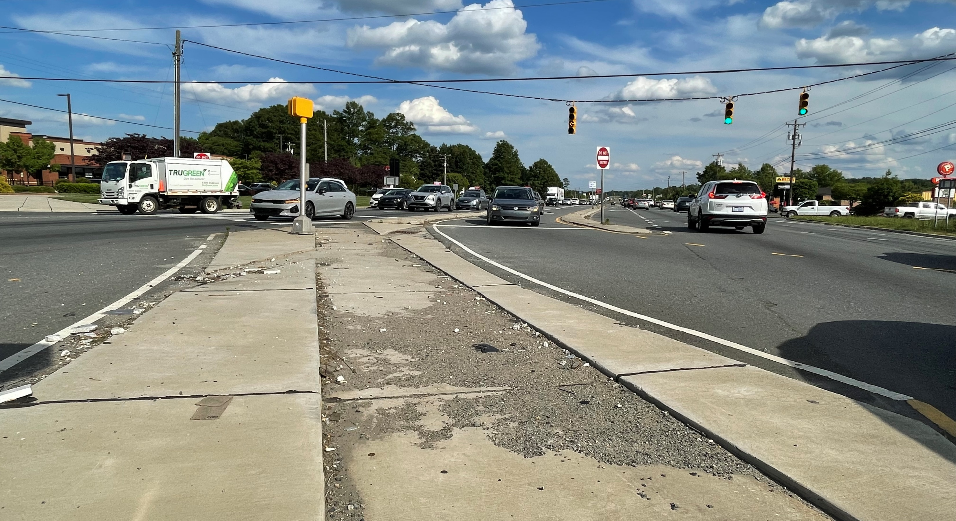
Safety problems prevent walking outside of neighborhoods.
WHY do you choose to NOT WALK somewhere?
Missing pedestrian facilities (no sidewalks, no crosswalks)
#1
Concerned for safety
#2
“It is difficult to cross 74 in cars. Walking is unimaginable.”

Slide 3
Online Survey – Free Response
“More sidewalks!”
“If you were to walk, you’d be risking your life”
“Would love to be able to walk more to or through town”
“I can't even walk my dog without fear of being hit on my side street. No lights and no sidewalk.”
“I hope you will invest in making this a safer and healthier community!”
“There are certain areas where sidewalks are choppy or don’t connect”
“We could walk to Food Lion and restaurants if we had sidewalk access from our neighborhood”
“Speed reduction and unsafe drivers have to be addressed or no one will feel safe walking.”
“Traffic in general can be prohibitive to walking or biking”

Slide 4
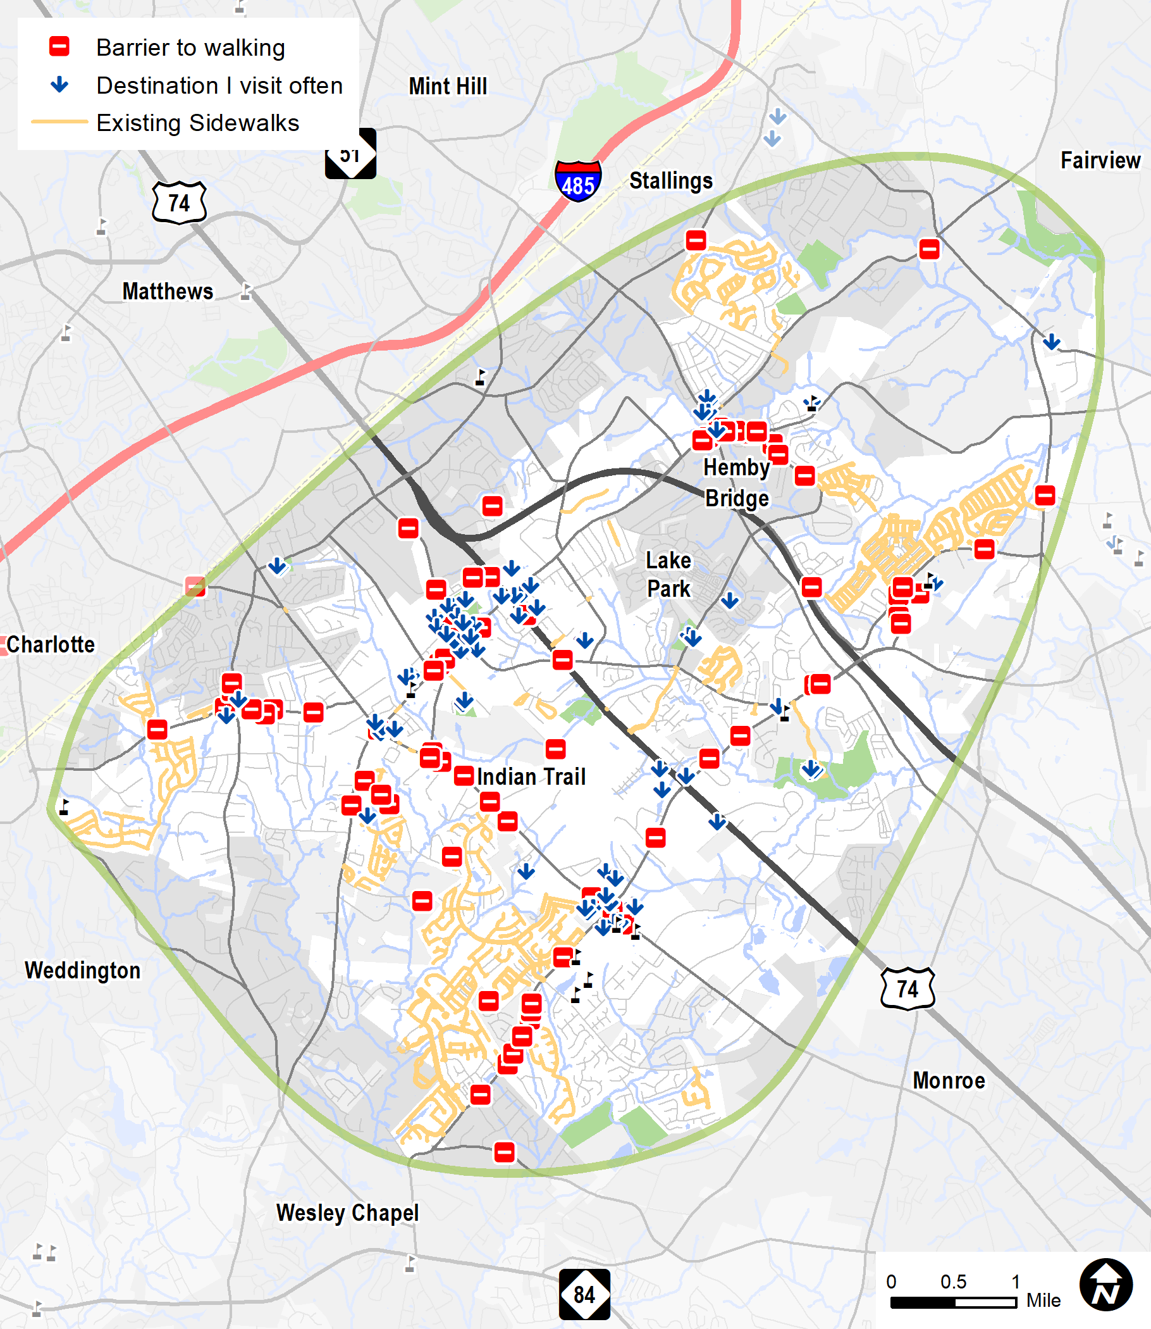
Interactive Map
346
Map comments
Barriers and destinations are clustered. Sidewalks are mostly in neighborhoods, not near the destinations and barriers.
“This neighborhood is close enough to the schools to walk but there is not a safe path.”
“A sidewalk connecting neighborhood to grocery store would be so helpful for those who cannot drive!”

